Slide 1
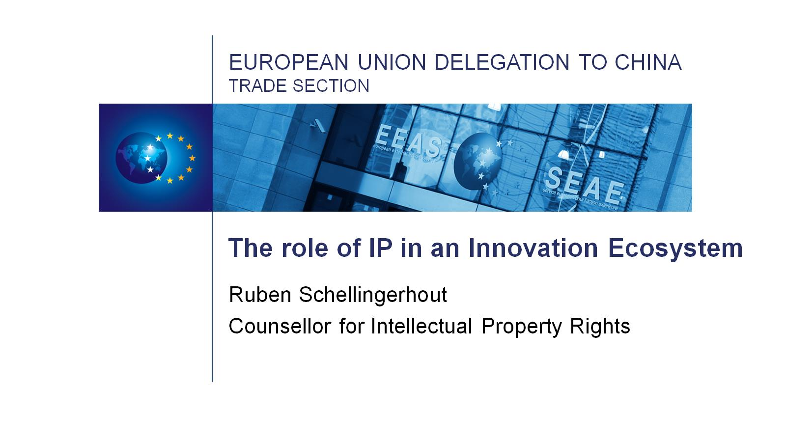
European Union Delegation to China Trade Section

Slide 2
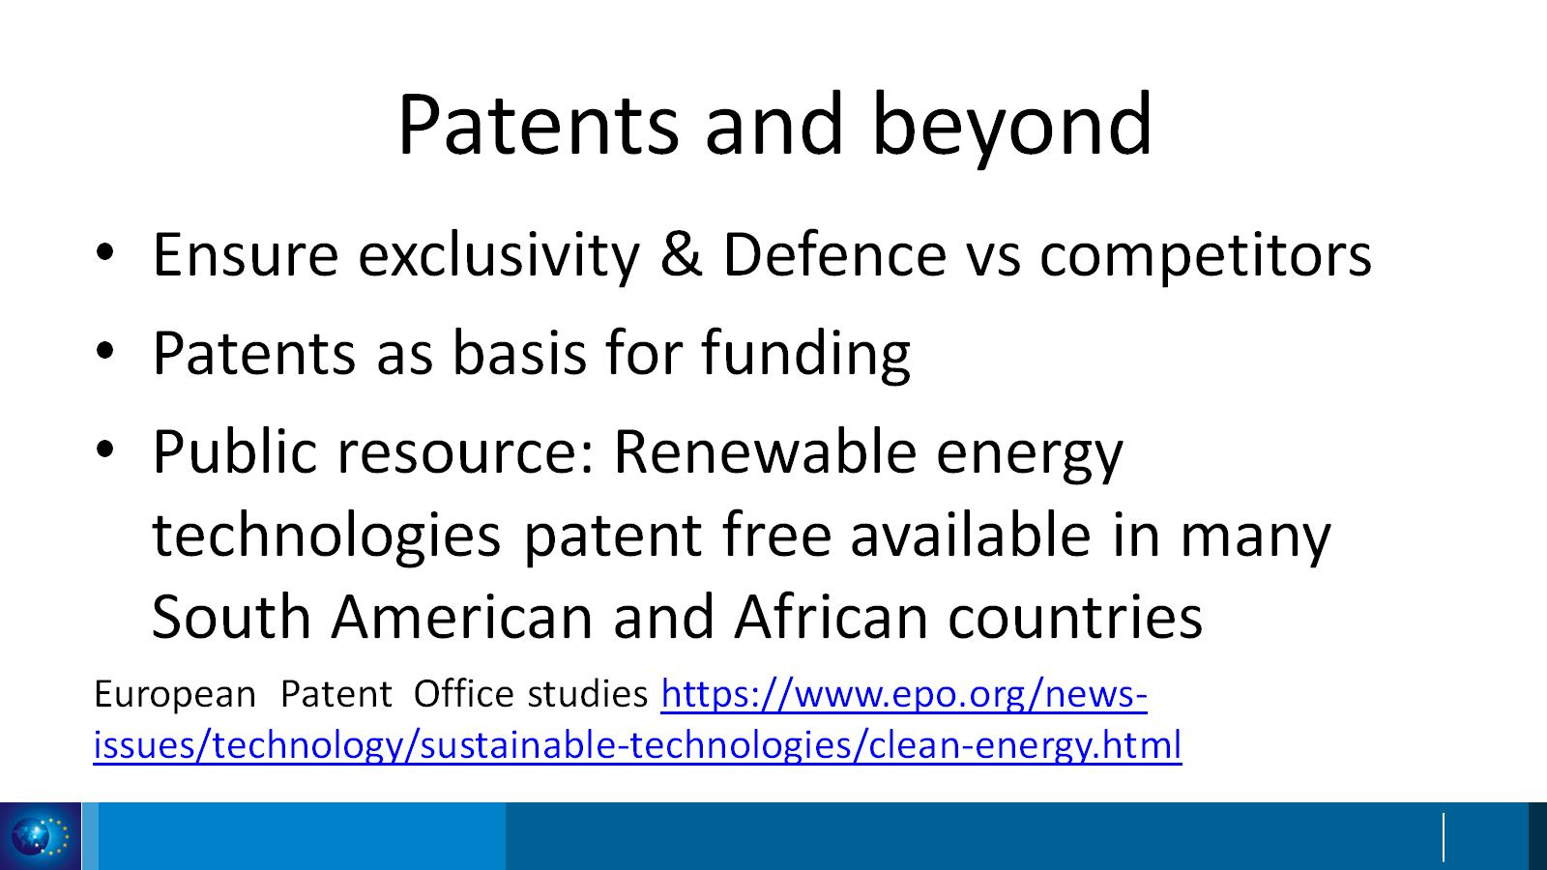
Patents and beyond

Slide 3
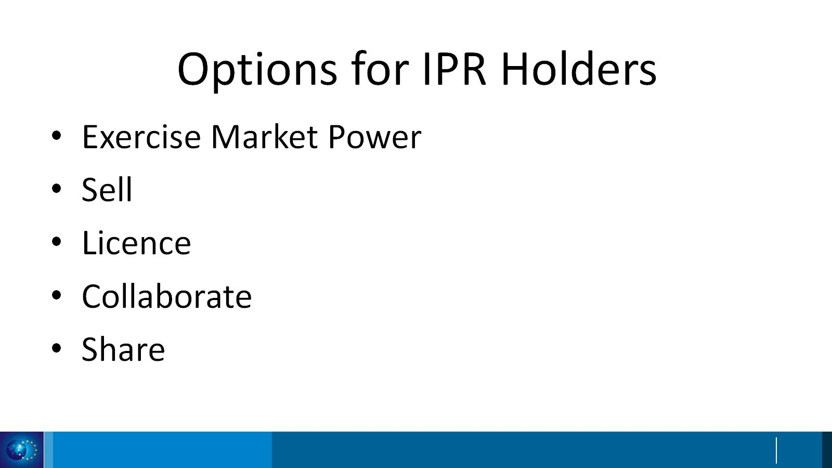
Options for IPR Holders

Slide 4
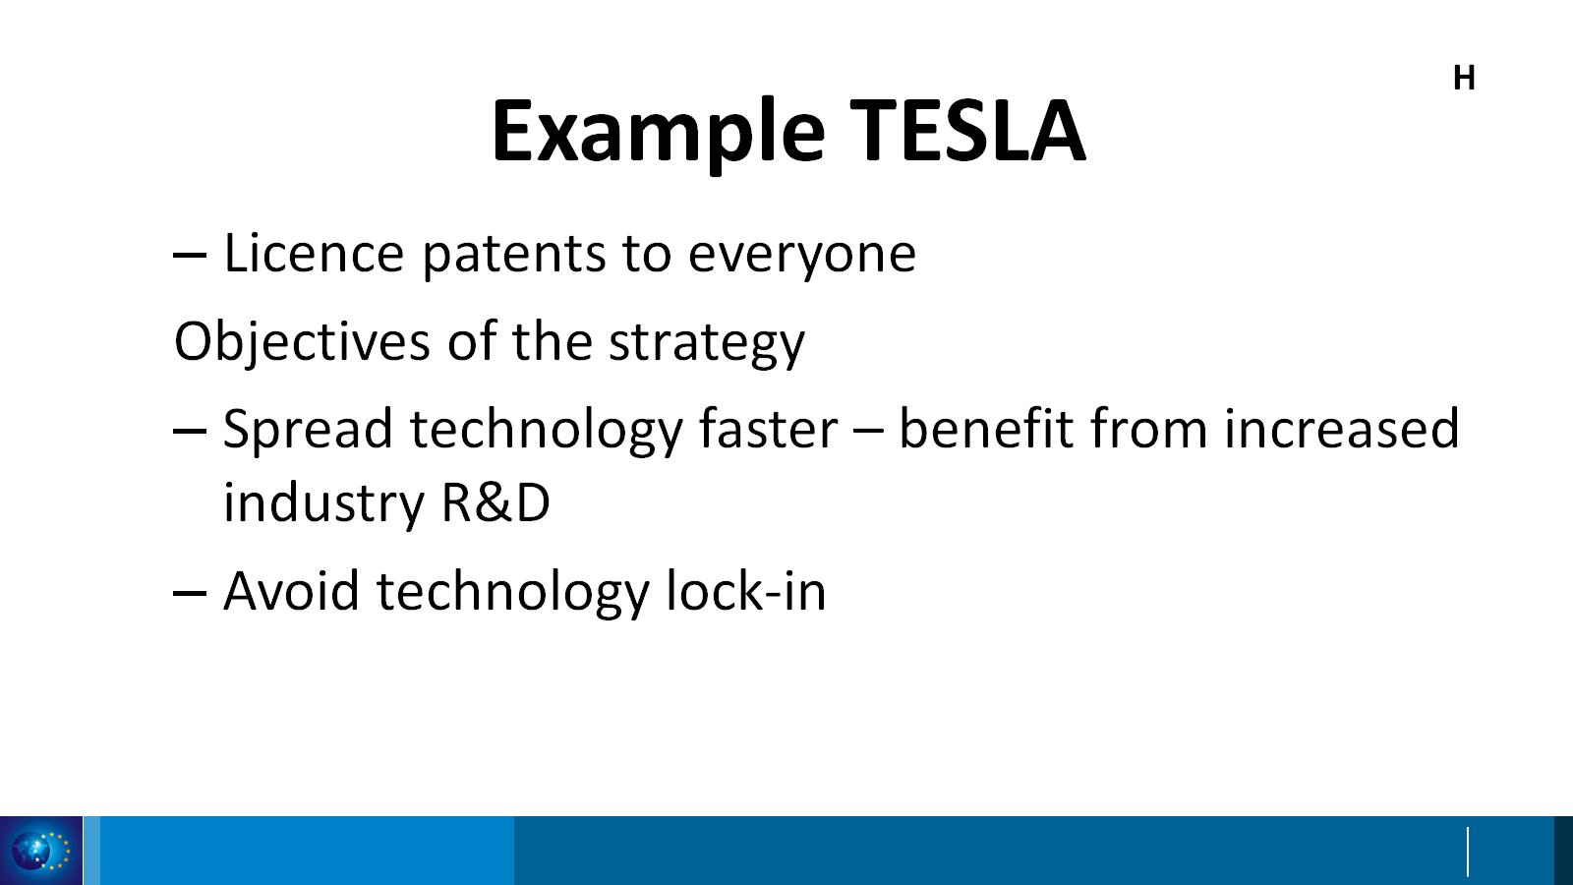
Example TESLA

Slide 5
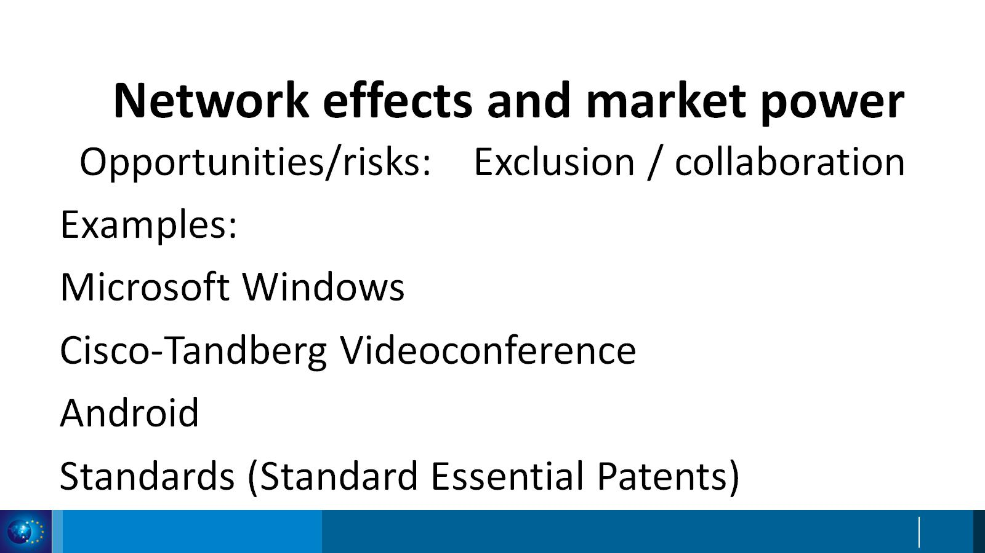
Network effects and market power

