Slide 1
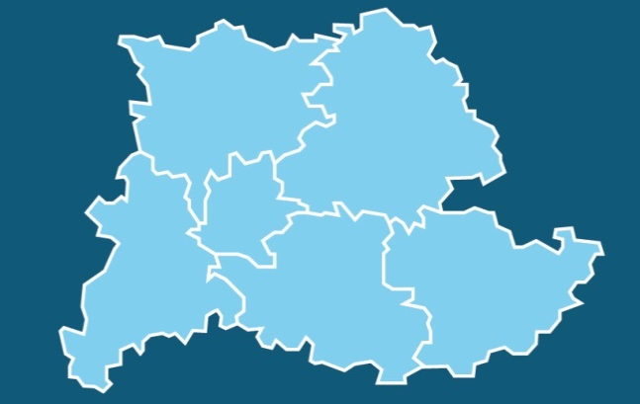
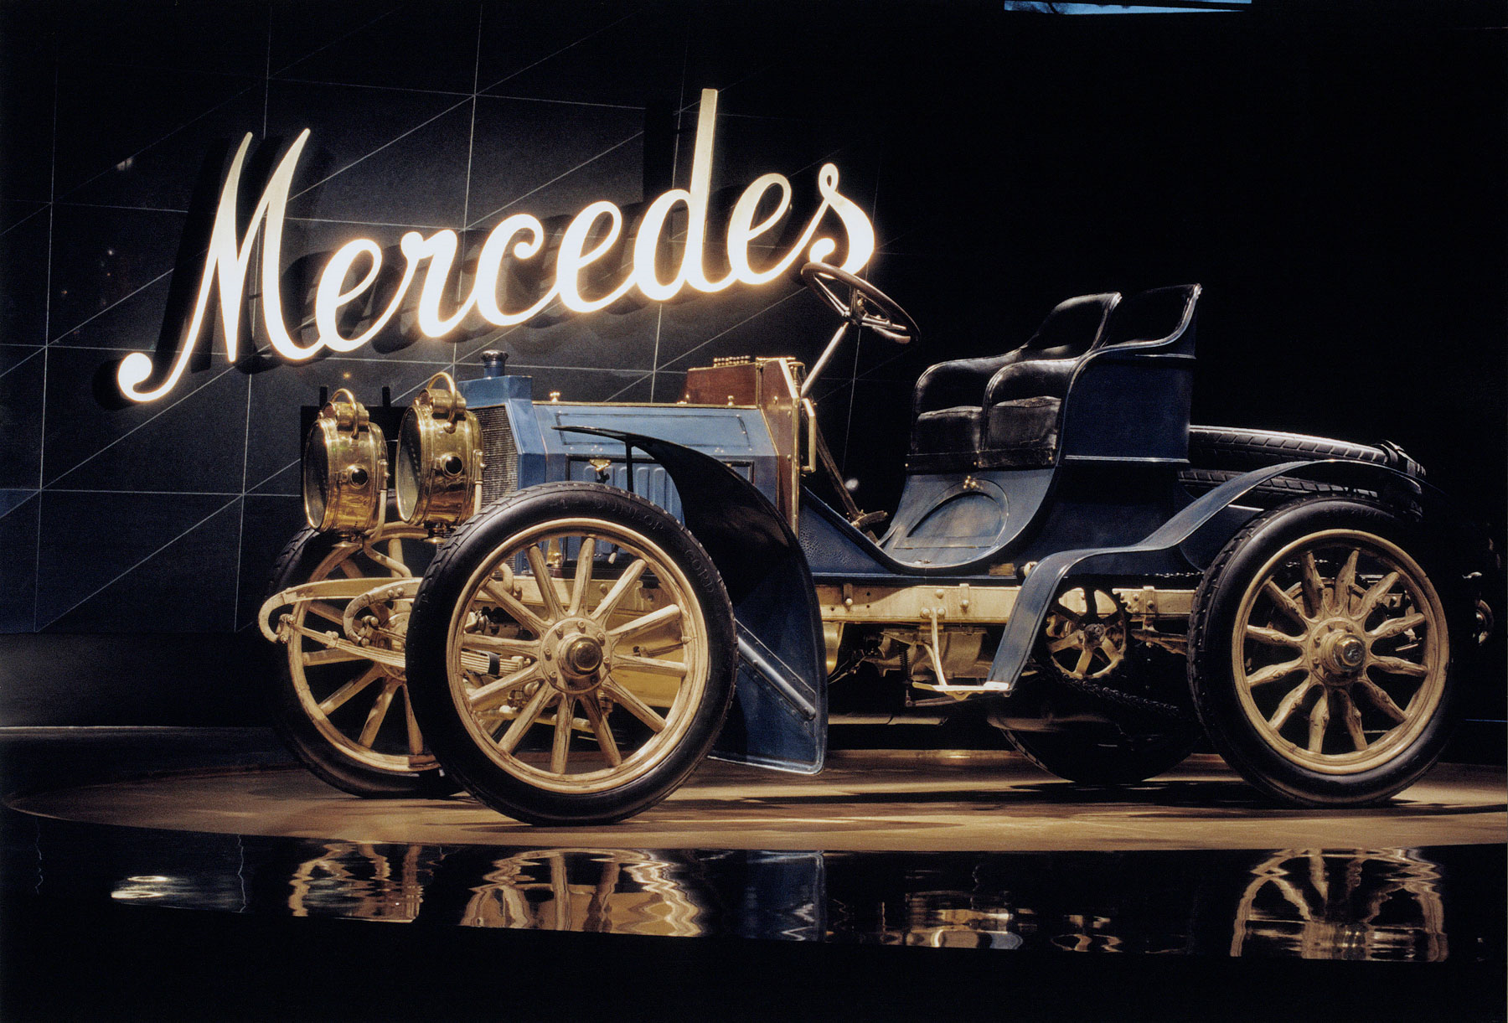

Transformation through Technological Innovation
Dr. Nicola Schelling
Regional Director
Verband Region Stuttgart
© VRS
© VRS / G. Stoppel
© VRS / M. Grohe
© Daimler AG

Slide 2
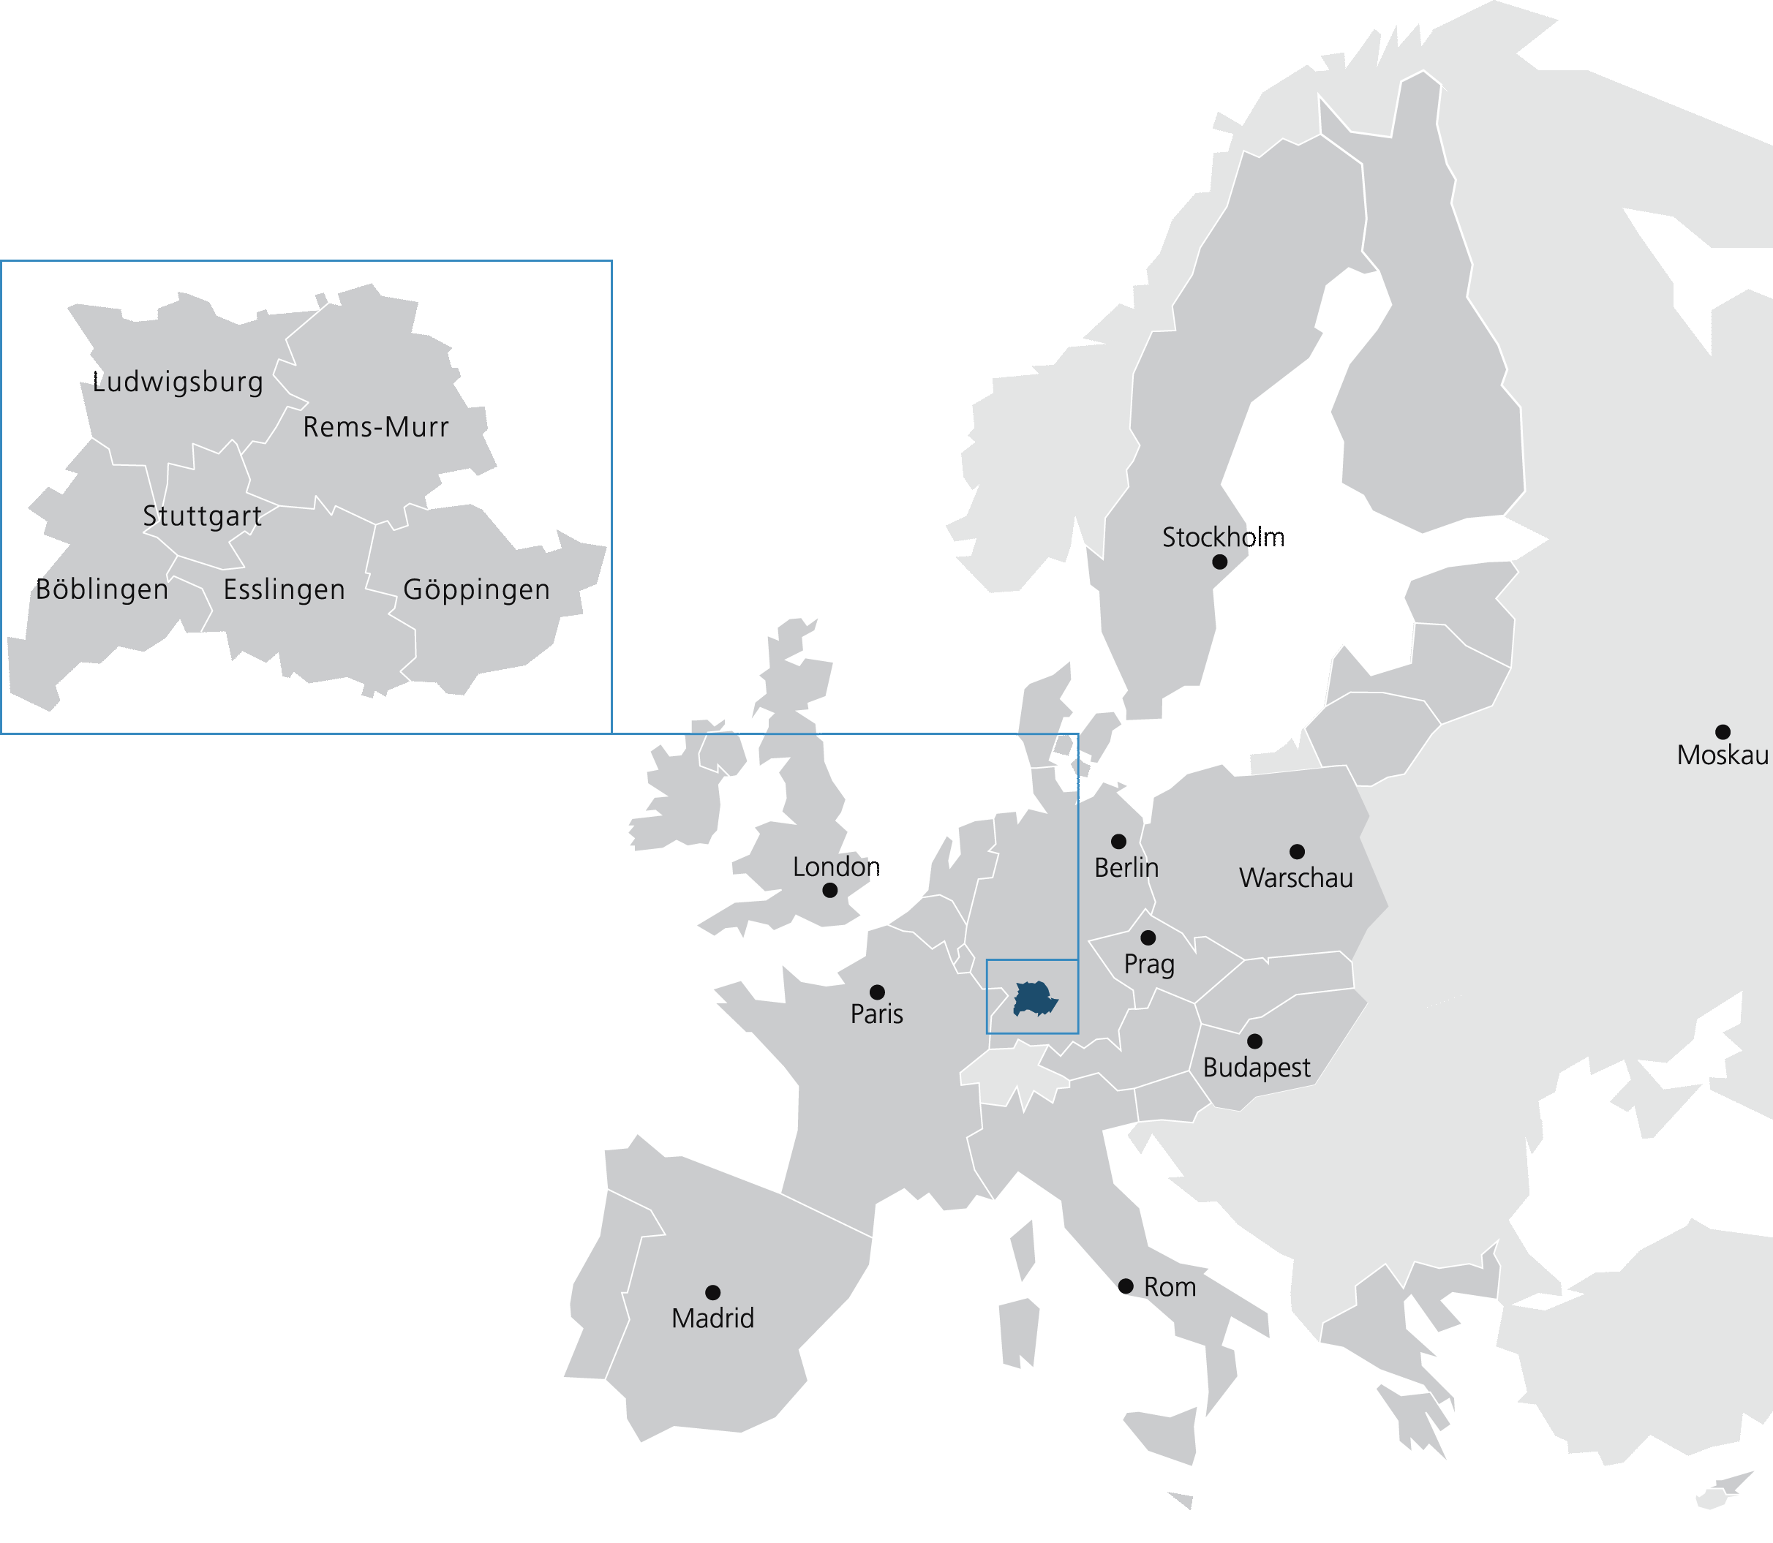
Stuttgart Region: located in the heart of Europe
Notes:
Honorable Mr Lan Shaomin (Nanjing Mayor),
Honorable Mr Nicolas Chapuis (EU Ambassador, the Delegation of the European Union to China),
Honorable Mr Eoin O'Leary (Irish Ambassador to China),
Distinguished Mr Bernhard Weber (Chairman of European Chamber Nanjing Board),
Distinguished speakers,
Dear Ladies and Gentlemen,
Thank you very much for inviting me to contribute to today‘s conference on behalf of Stuttgart Region.
In the beginning, I would like to show you where we are located:
As you can see on the map, the Stuttgart Region is located in the heart of Euope, in the Southeast of Germany.
The Region comprises the city of Stuttgart and its five surrounding districts.
The following slide will illustrate you some key numbers regarding the Stuttgart Region.

Slide 3
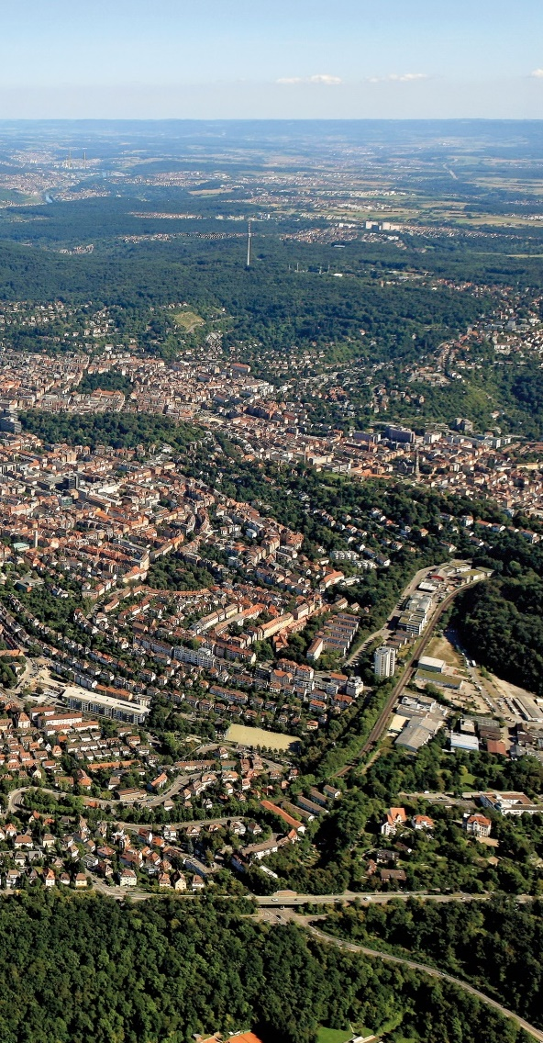
Key numbers of the Stuttgart Region
  179 towns and municipalities
  2.78 million inhabitants from 170 countries
    Nanjing: 8.3 million inhabitants
  Surface area 3,654 km²
  Nanjing: 6,587 km²
  761 inhabitants/km²
  EUR 144 billion gross domestic product (2016)
    Nanjing: EUR 136 billion (2016)
© VRS / M. Grohe
Notes:
179 towns and municipalities
→ We are a polycentric region.
2.78 million inhabitants from 170 countries
Nanjing: 8.3 million inhabitants
Nanjing‘s population is almost three times bigger than the population of Stuttgart Region
Surface area 3,654 km2
Nanjing: 6,587 km2
Our surface area is half as big as Nanjing‘s surface area
761 inhabitants/km2
→ Quite densely populated for European standards
EUR 144 billion gross domestic product (2016)
Nanjing: EUR 136 billion (2016)
→ Our GDP is a bit bigger than the GDP of Nanjing

Slide 4
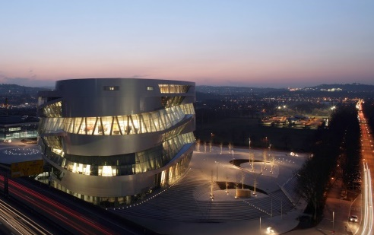
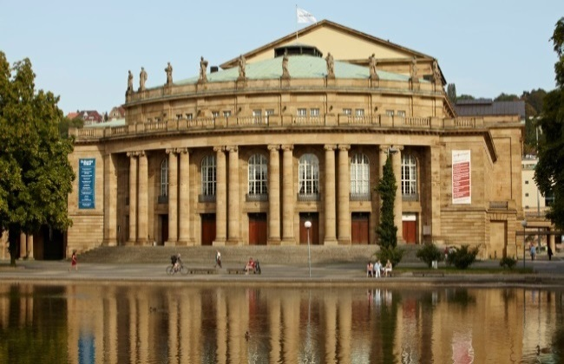
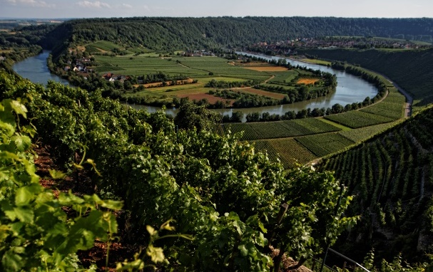
Characteristics of the Stuttgart Region
  Most important sectors: Automotive, mechanical and electrical engineering, IT
  Percentage of those employed in the…
    Manufacturing sector: 33.9% (19.4% Munich)
    Services sector: 65.8% (80.4% Munich)
    Agriculture sector: 0.3% (0.2% Munich)
  Head office of world famous firms: Daimler, Porsche, Bosch, IBM, Stihl, Festo
  R&D Quota: 6.6%
© Stuttgart Regio Marketing GmbH
© Stuttgart Regio Markeing GmbH
© VRS / G. Stoppel
Notes:
As you may know, the Stuttgart Region is one of the world's leading centers of the automotive industry.
Within the Stuttgart Region, nearly 20% of all employees work in the automotive industry.
Other important sectors are mechanical and electrical engineering and also IT.
In percentages this means that more than a third of our workforce is engaged in the manufacturing sector, and about two thirds in the service sector.
So - in the German context - compared to Munich, the percentage of people working in the manufacturing sector is quite high. This can mainly be explained by the fact that, although we are home to companies that operate worldwide, Stuttgart Region is still a main production site for them.
Stuttgart Region is home to head offices of world famous firms: Daimler, Porsche, Bosch, IBM, Stihl, Festo
An important measure of the innovative capacity of a country or region is the Research and Development quota - the share of research and development expenditure on the total gross domestic product. The companies in the region invest more in research and development than anywhere else in Germany: 6.6% of the total economic output is invested in R&D. For comparison: Sweden: 3,3%, Germany: 2%, Italy 1,3%; Munich region: 3.5%, Dresden region 2.3%

Slide 5
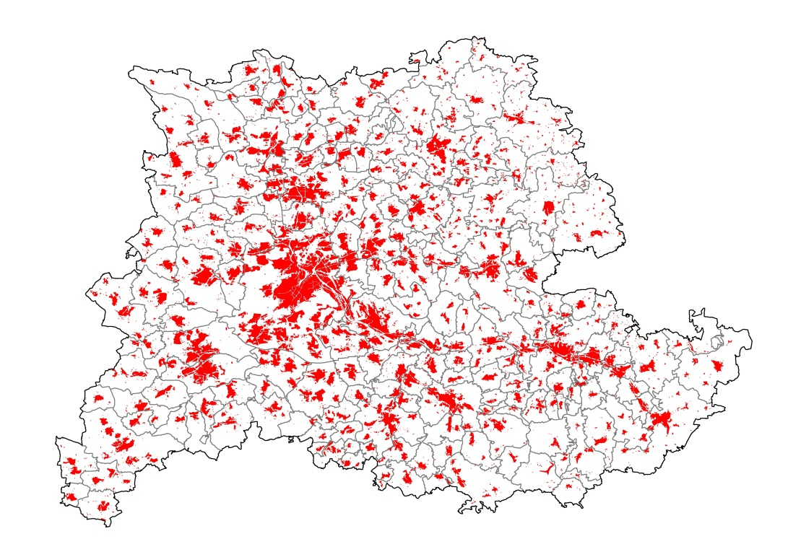
Mobility as a regional challenge
Regional lifestyle:
75 % of all employees are commuters
900.000 commuters accross municipal borders each day
97 % of the public transport trips start and end within the region
253.000 persons commute daily to the city of Stuttgart
90.000 persons commute daily from the city of Stuttgart to other municipalities
Car as main means of transport: 58 % use the car to travel
© VRS 2013
Notes:
A good example to illustrate the regional lifestyle of our citizens which also underlines the importance of our work on regional level is the topic of mobility.
On the picture, you can see our built up area which demonstrates that we are a polycentric region that consists of more cities than the city of Stuttgart.
Mobility is a challenge that exceeds the boundaries of one local authority:
• 75% of the employees in the region do not work at their place of residence
• We have 900.000 commuters across municipal borders each day
97 % of the public transport trips start and end within the region
Approximately 253.000 persons commute daily to the city of Stuttgart
Approximately 90.000 persons commute daily from the city of Stuttgart to other municipalities in the region
Most people, in fact 58%, use the car to travel within the region. Thus, the car is the main mean of transport.

Slide 6
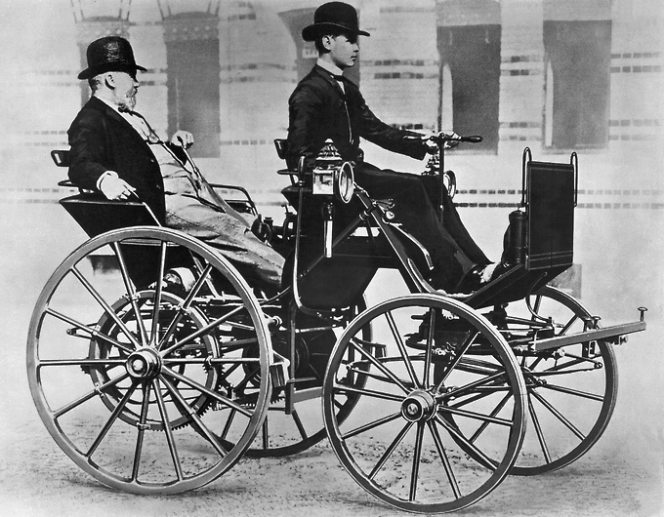
Innovation is part of our DNA
  Cradle of the car
  1886 invention of the first automobile
  Gottlieb Daimler and Carl Benz
© Daimler AG
© Daimler AG
© Stuttgart Regio Marketing GmbH
© VRS / G. Stoppel
Notes:
Innovation is part of our DNA in the Stuttgart Region. One example of this historic innovative capability is the invention of the automobile:
Stuttgart Region is the cradle of the car: In 1886, two engineers named Gottlieb Daimler and Carl Benz almost simultaneously invented the automobile. The two companies that emerged from the work of those two pioneers joined their forces in 1926 and created the world famous company we know today as Daimler.
When the first automobile was invented, people were very sceptical if this technology will prevail in the future. Even the ruling Emperor Wilhelm I said that the automobile is only a temporary appearance. He believed in horses as the main mean of transport. In the beginning, automobiles were being promoted as being more environmentally friendly than horses, since the streets were not polluted by horse dung. Nowadays the next challenge is that cars are faced with scepticism due to the emission of particulate matter and nitrogen dioxide. So, we are at a similar point as when the automobile was invented due to the environmental challenges of transport.
I am certain that the car still provides the best mean of transport for every individual‘s needs. The key to deal with the current environmental challenges of today‘s cars is innovation! Innovation is part of our evolution, innovation is a process that is happening all the time. So, we have to ask ourselves how can we make driving in a car more sustainable and more intelligent?

Slide 7
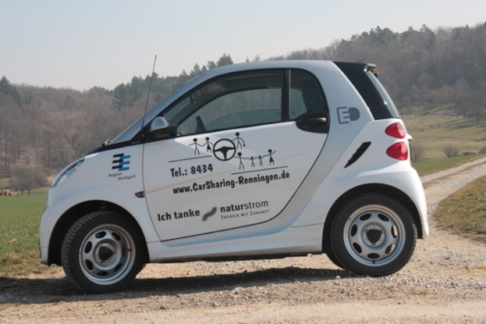
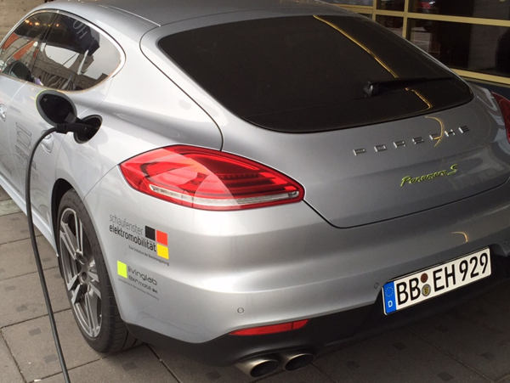

Innovation is part of our DNA
  Key innovations:
  e-mobility (sustainable technology)
  autonomous driving (intelligent technology)
  mitigate air pollution and improve traffic flow
© Stuttgart Regio Marketing GmbH
© Stuttgart Regio Markeing GmbH
© VRS / G. Stoppel
© WRS/ Jochen Breutner, Ökostadt Renningen e.V
© Thomas Kiwitt
Notes:
Two innovations will be the most prominent: Autonomous driving and electromobility. Both technologies combined will be the key future developments. E-mobility as a sustainable technology can mitigate air pollution and autonomous driving as an intelligent/smart technology can help to improve traffic flow and reduce congestion. In order to show their full potential, both innovations have to be suitable for everyday use. This is the main challenge right now. Moreover, it is also still questionable whether it will be a disruptive development or whether we solve today’s problems via innovation in a longer process.

Slide 8


Innovation structure
  Cooperation between science, education and companies
  Vocational training: dual system of training
  Dual university Baden-Württemberg
  Transfer of technology: Launching new products on the markets
  Political level sets the framework conditions
© Stuttgart Regio Marketing GmbH
© VRS / G. Stoppel
© creativa/fotolia.com
© fotogestoeber/fotolia.com
Notes:
Why is innovation part of our DNA? I would like to briefly explain our innovation structure to you:
In general, we have a close cooperation between science, education and companies in our region.
This is expressed in our vocational training that consists of a dual system of training: The apprentices are trained at the respective company and at special vocational schools. This ensures a close connection between education and the need of the companies.
For a higher degree of education, we also have a special dual university that provides scientific training at a university and at the same time, the students work at the cooperating company. This ensures a true application-oriented scientific education.
Therefore, the transfer of technology from research and science to the companies is naturally happening. Thus, new products can quickly be developed and launched on the market. This is a system we trust in.
In addition, the political level has to set the framework conditions so that innovation can unfold its full potentials. I would like to explain this to you in more detail with the example of the development of e-mobility.

Slide 9
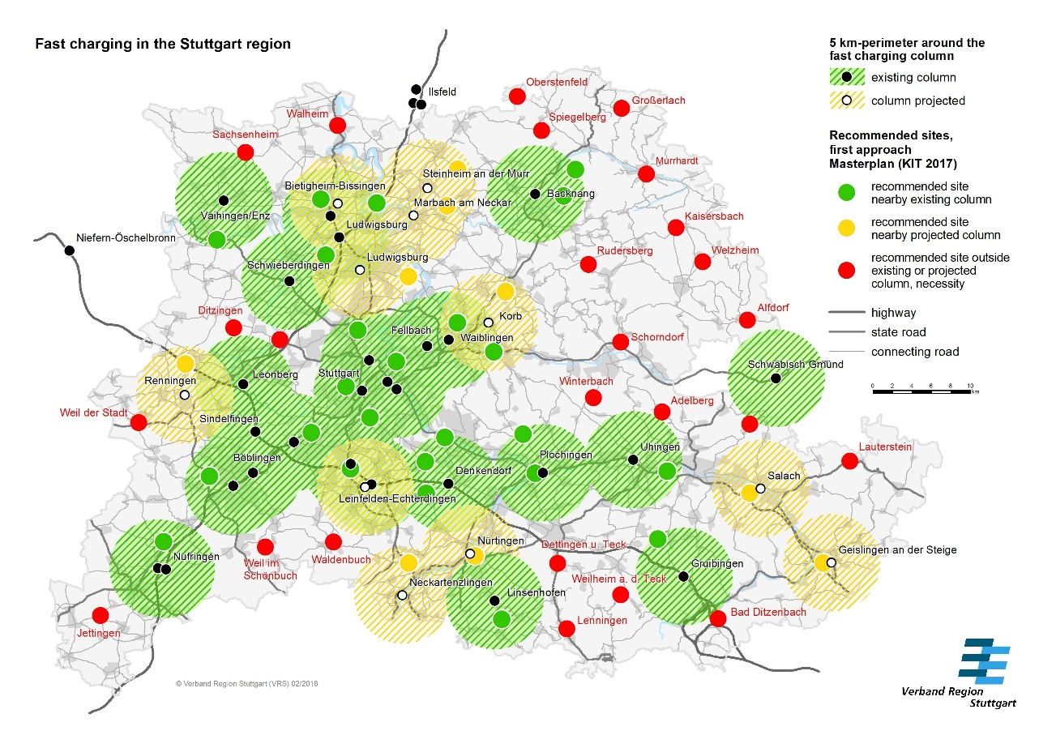
Guaranteeing the framework conditions for innovation
© Stuttgart Regio Marketing GmbH
© Stuttgart Regio Markeing GmbH
© VRS / G. Stoppel
Notes:
As local authorities, we have to guarantee that the framework conditions for the daily use of innovations are met. Concerning e-mobility, we believe that everyone should be able to find a fast charging station within ten minutes. So, everyone should be able to rely on a public charging infrastructure, similar to normal petrol stations. Therefore, we have created a master plan for a network of fast charging stations in the Stuttgart Region. Around 60 fast charging stations are required across the region which are then accessible within ten minutes for everyone. As a second step, we work together with the municipalities to apply for funding, in addition to activities from the private sector, to construct the charging stations.
We all have to work together to achieve this goal - politics, car manufacturers, electricity providers and network operators. After all, networking - in the truest sense of the word - plays a major role in the field of electromobility. If we then introduce a uniform system for charging the e-vehicles - for example, with easy payment options at each station via credit card - and further increase the range of electric cars, we have reached key milestones.
To sum up, I hope that I could show you how innovation – especially in the automotive sector - has always been a key success factor of our region and we are committed that this historic path continues in the future.

Slide 10
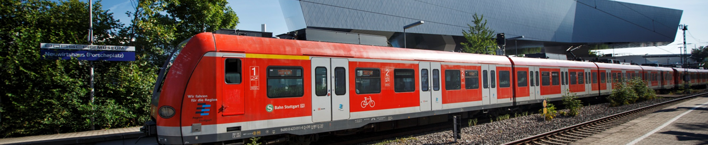
Dr. Nicola Schelling, Regional Director
© VRS / G. Stoppel

Slide 11
Status Quo: E-Mobility in the Stuttgart Region
  Stuttgart Region is one of four excellent clusters for electric mobility in Germany
  Own regional funding program for sustainable mobility
  Big electric car-sharing fleet (car2go: 400 eSmart, 100 B electric drive)
  83.000 BEV are registered in Germany, whereof 7 % are registered within Stuttgart Region (covering an area of 3% of Germany)
  bike sharing system with one-way functionality: 600 bikes and 150 pedelecs at 130 renting stations
© Stuttgart Regio Marketing GmbH
© Stuttgart Regio Markeing GmbH
© VRS / G. Stoppel
Notes:
I am aware that China is very advanced in the deployment of e-mobility which is a challenge for us.
I would like to introduce our current status quo to you:
Stuttgart Region is one of four excellent clusters for electric mobility in Germany
Furthermore, we have an own regional funding program for sustainable mobility that also promotes e-mobility
We have a big electric car-sharing fleet called car2go, that provides 400 eSmart and 100 B electric drive
83.000 BEV are registered in Germany, whereof 7 % are registered within Stuttgart Region (covering an area of 3% of Germany)
We also have a regional bike sharing system with one-way functionality: 600 bikes and 150 pedelecs are availabke at 130 renting stations
To sum up, I hope that I could show you that innovation – especially in the automotive sector - has always been a key success factor of our region and we are committed that this historic path continues in the future.

