Slide 1
Prosumer Era
of Future Energy
Kaikai Yang
Dipole Tech

Slide 2

We are facing an unprecedented global emergency.
Life on Earth is in crisis: scientists agree we have entered a period of abrupt climate breakdown, and we are in the midst of a mass extinction of our own making.
-Extinction Rebellion

Slide 3
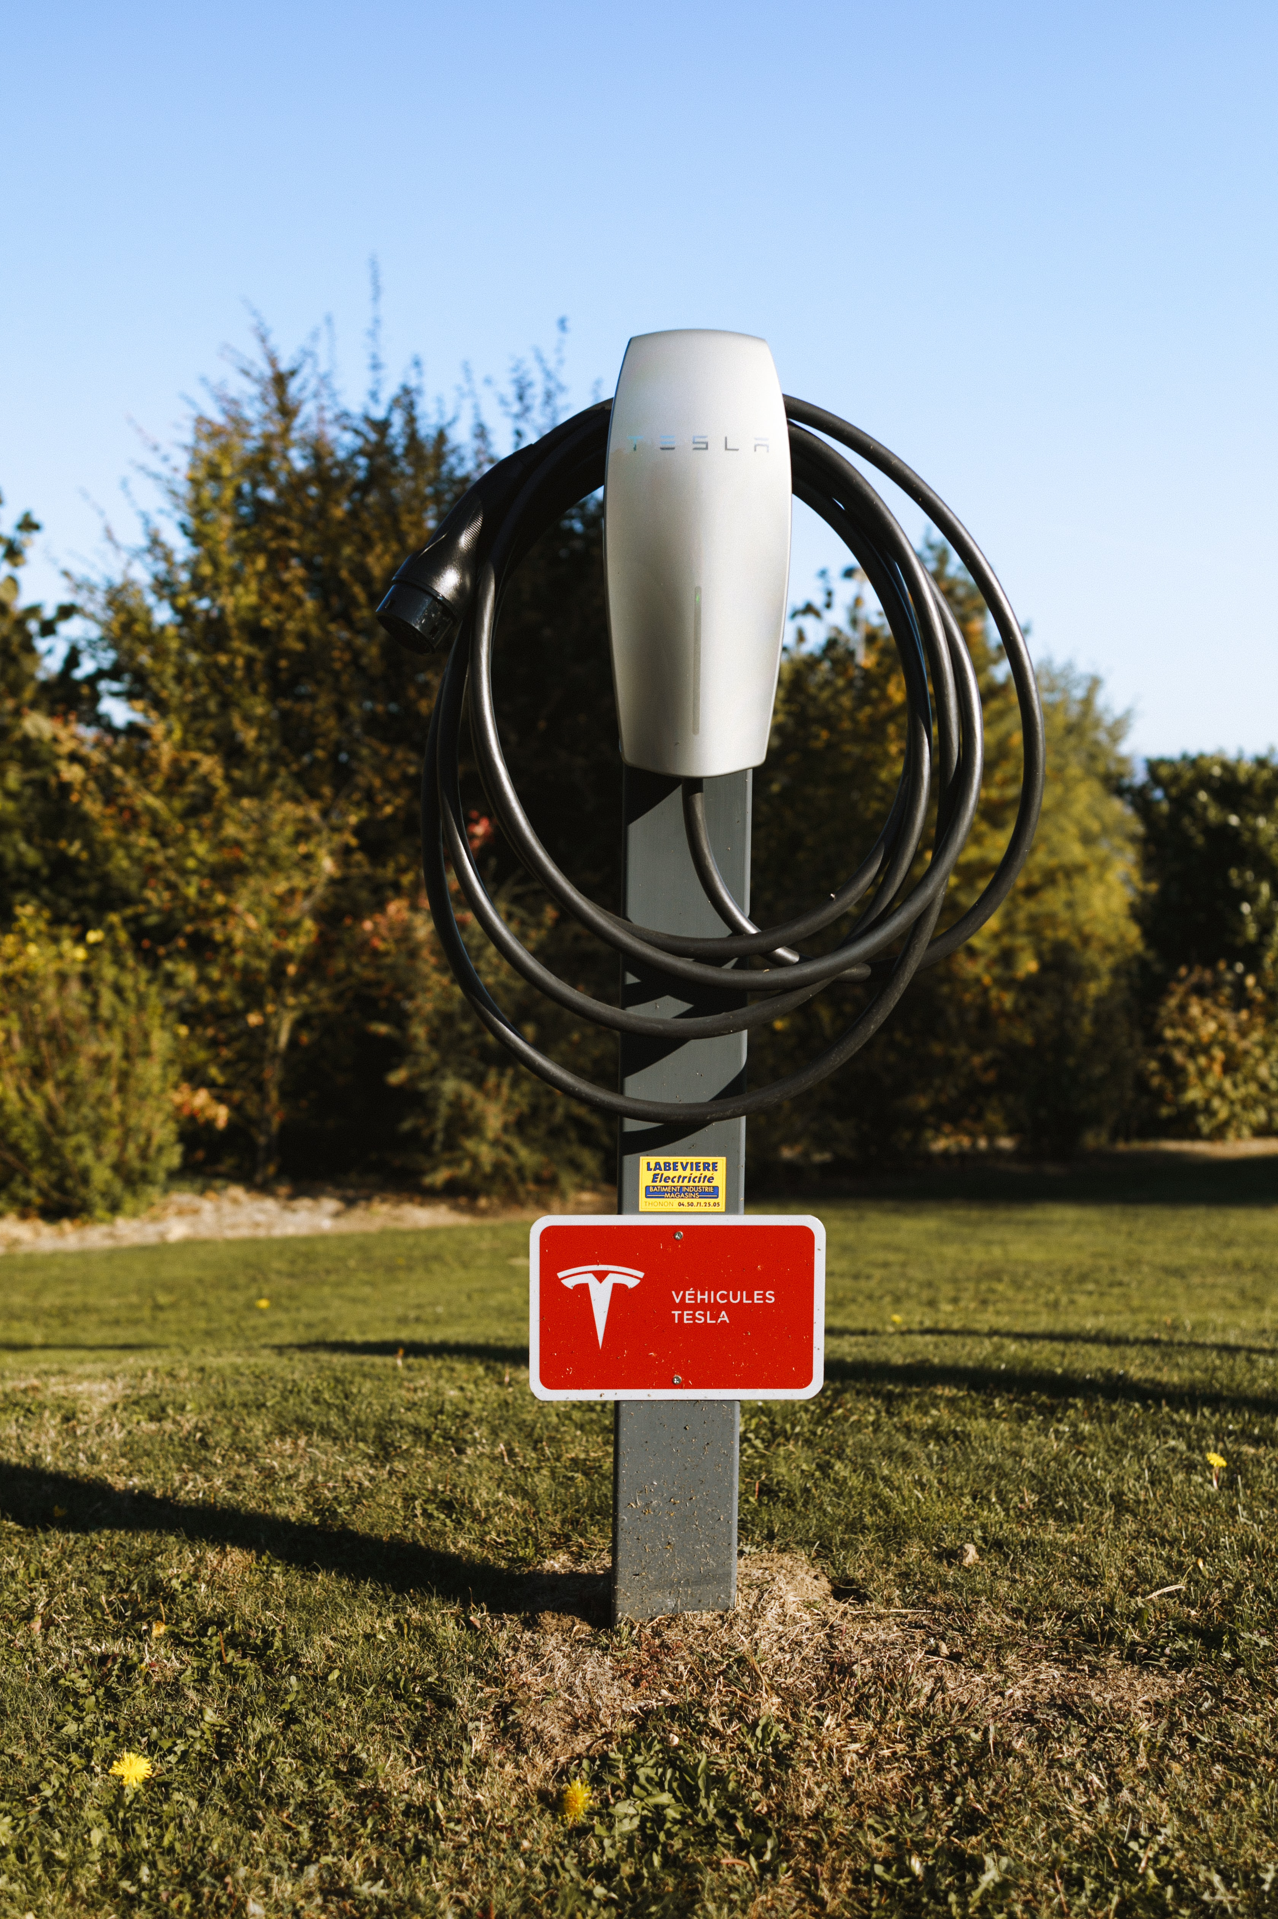
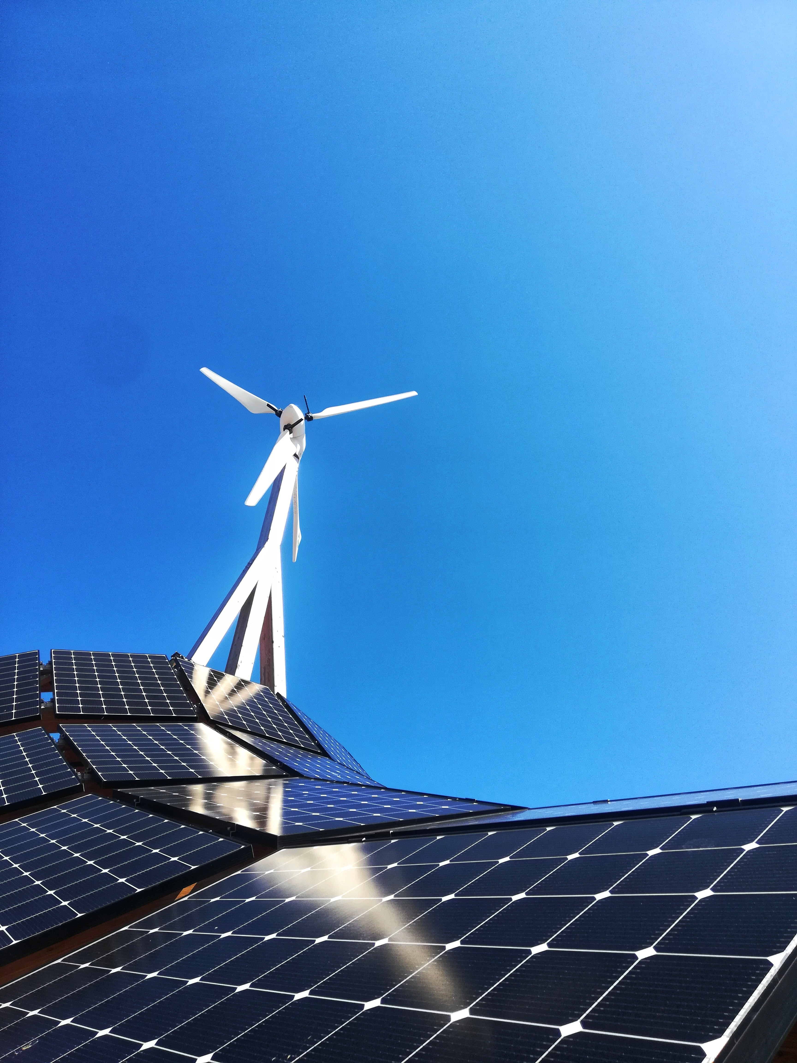
By 2020, onshore wind and solar PV will be a less expensive source of new electricity than the cheapest fossil fuel alternative.

Slide 4

Background
Paradigm in Energy Structure
Renewable energy represented by photovoltaics has become affordable and accessible, and with its explosive growth on the horizon, the new energy market is a vast blue ocean.
Standardized Products/Services
Electricity products are highly standardized and enjoy stable and predictable cash, making them ideal for being transformed into digital asset on blockchain.
Dispersive Property Rights
Property rights of distributed energy asset is usually dispersive, and the market presents demand in trading electricity products and energy asset.
Why does Dipole focus on distributed energy?
Why does distributed energy need new microfinance infrastructure?
To Establish an Asset/Capital Distribution System and Facilitate Asset/Capital Flow in the Energy Sector
Based on blockchain technology, Dipole sets up a capital/asset distribution system, connecting cash flow of energy asset with microfinancial services. The system helps energy asset holders to deliver better products and services and to have easier access to financing, while helping investors to discover quality energy asset.

Slide 5

Consumer
vs
Prosumer

Slide 6

Centralized
vs
Decentralized

Slide 7

We build
VIRTUAL POWER PLANTS.

Slide 8
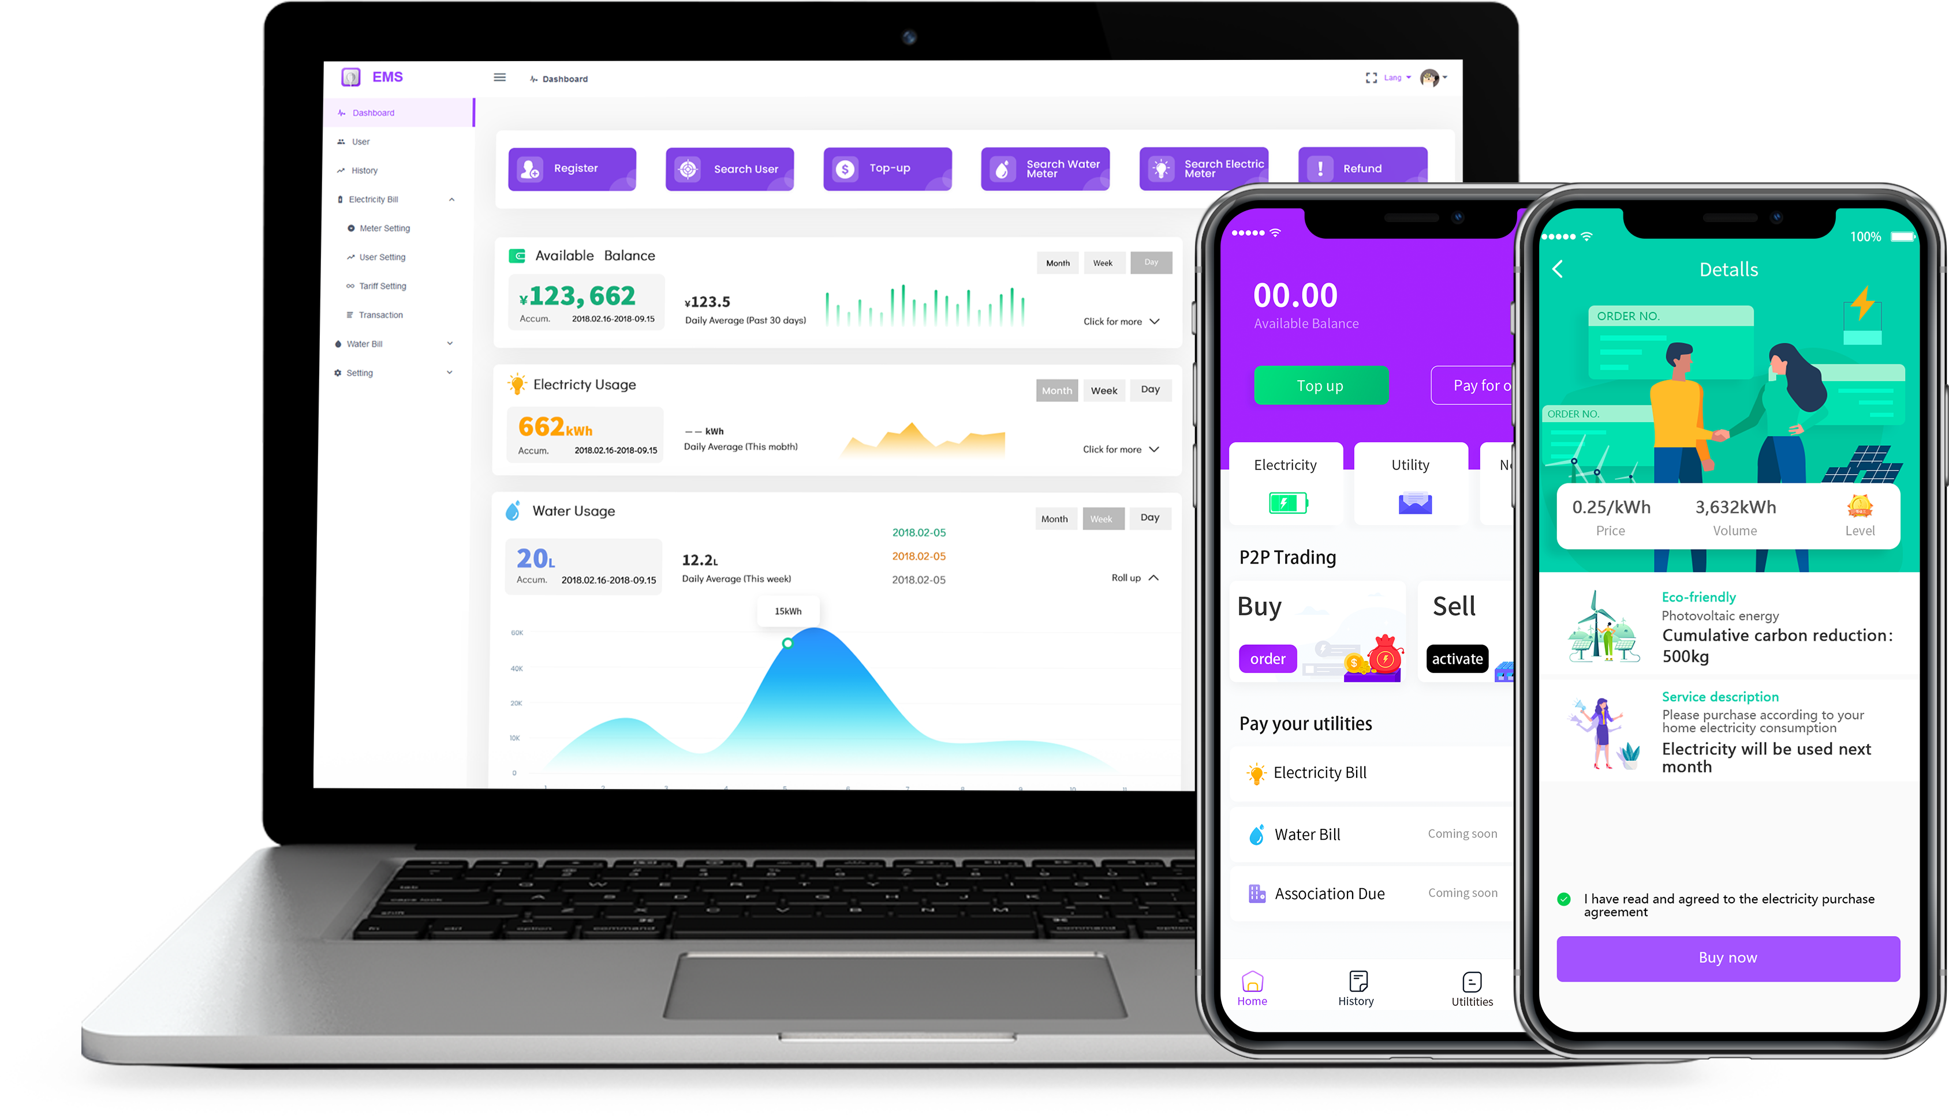
Products
Aggregator:
E-pool: Distributed Energy Trading Network
A-pool: Distributed Energy Asset/Capital Distribution Network
Product:
EMS: Management Platform for Regional Energy Market
Wattime: Mobile App

Slide 9

YOU
are able to own
an electricity ebay!

Slide 10
Let’s leave the fossil fuels underground.
Thanks For Watching

