Slide 1
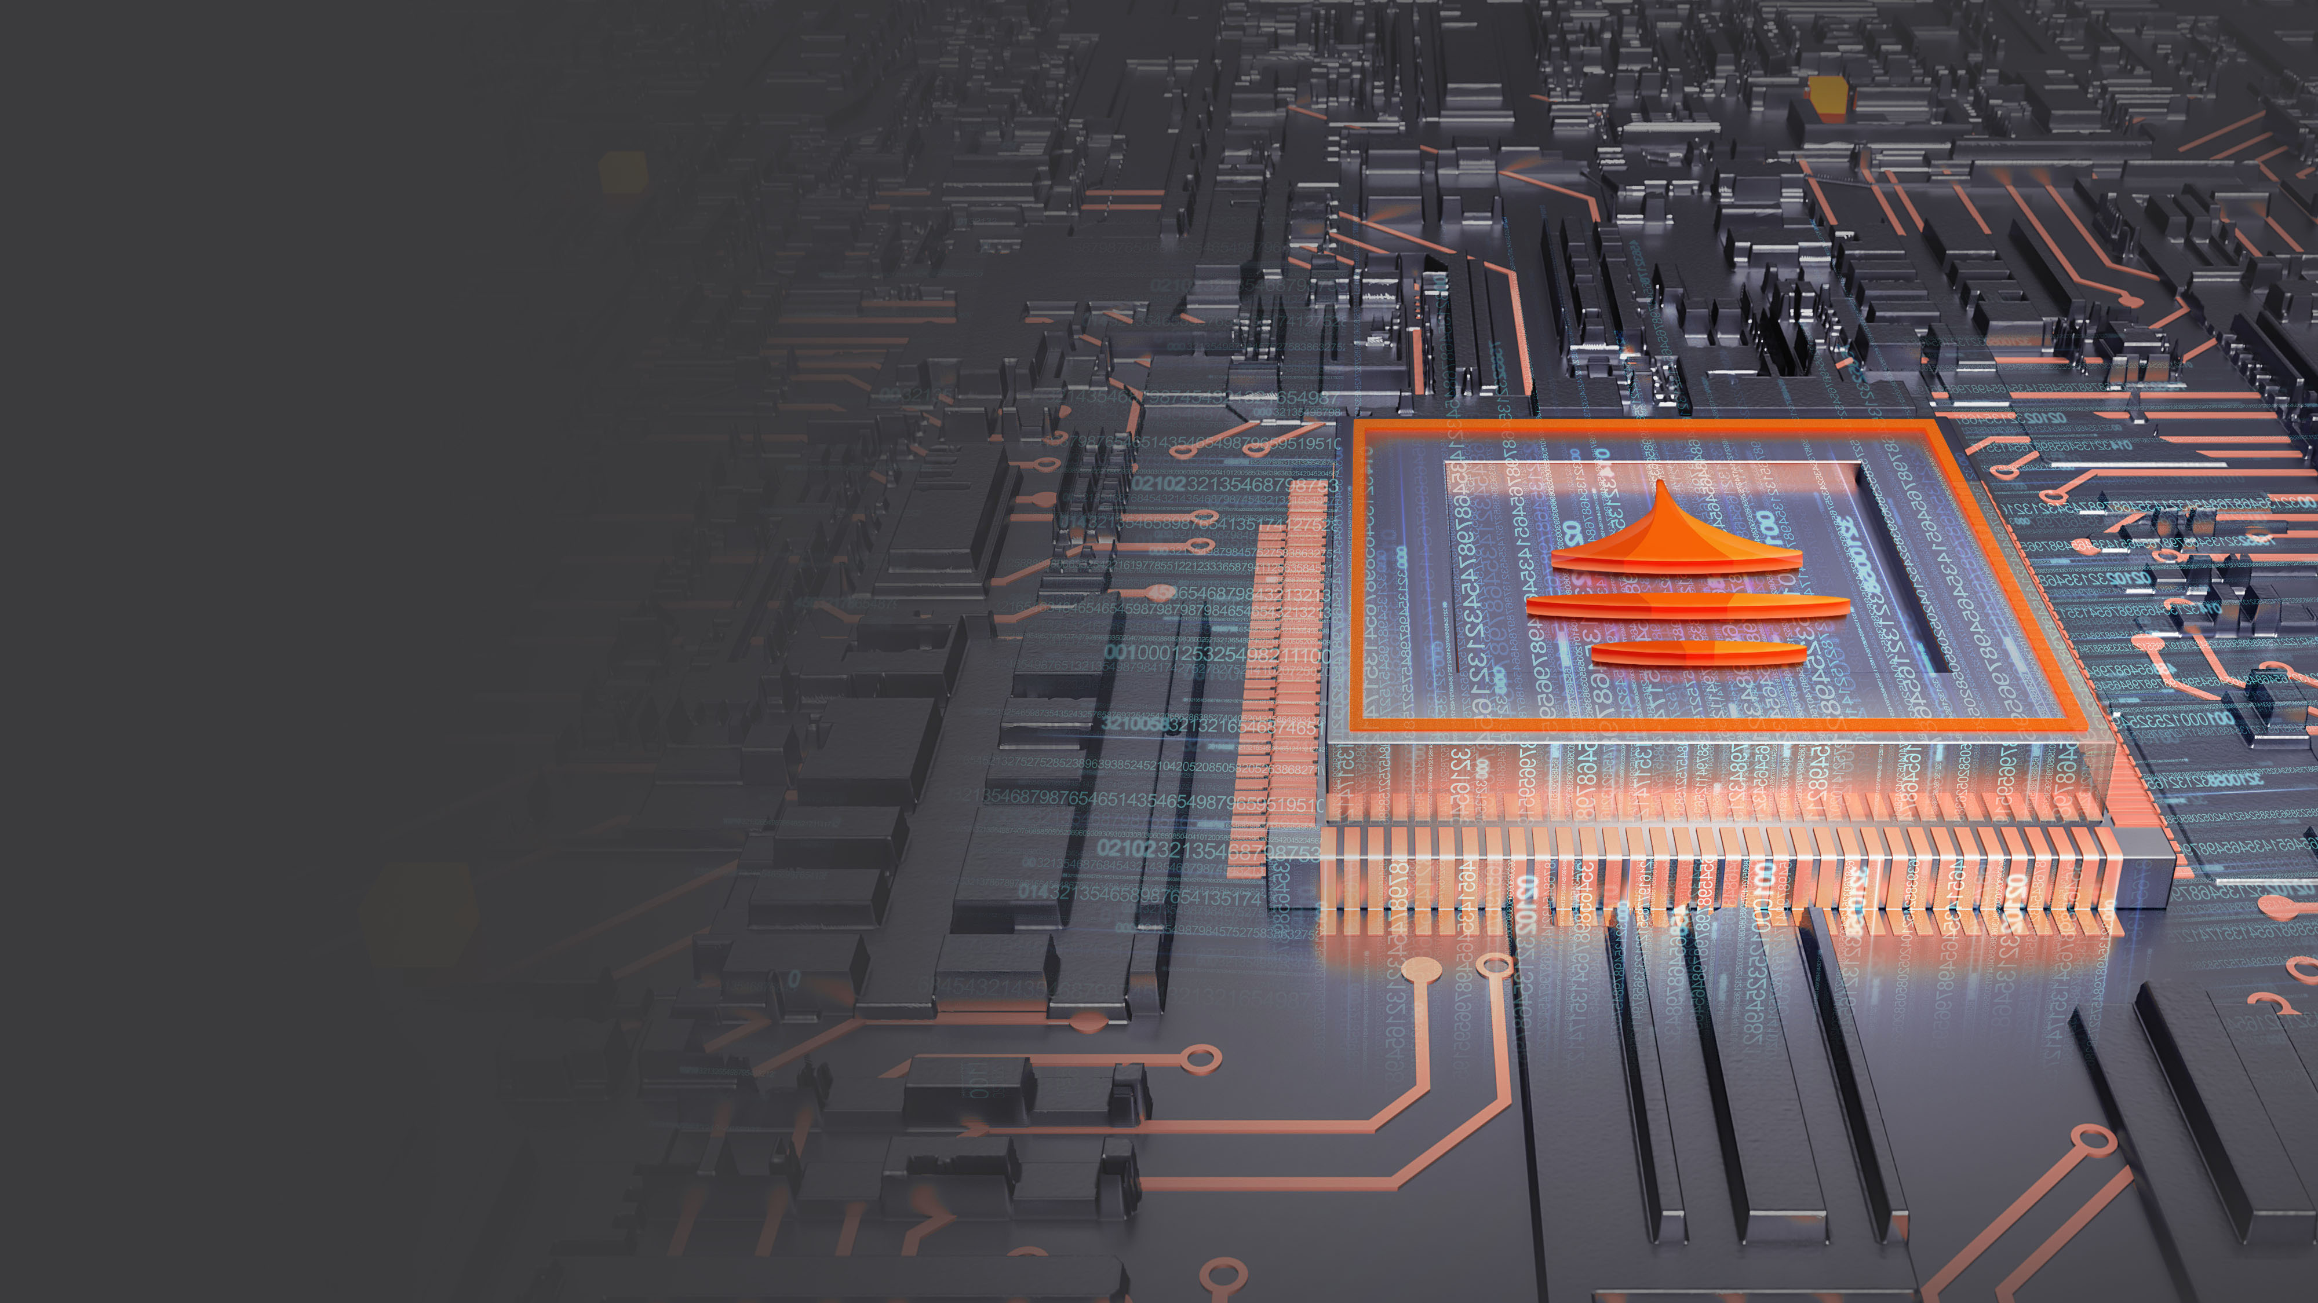
RIVTOWER：Energize Digital Economy
RIVTOWER：
Energize Circular Economy
2020/11

Slide 2











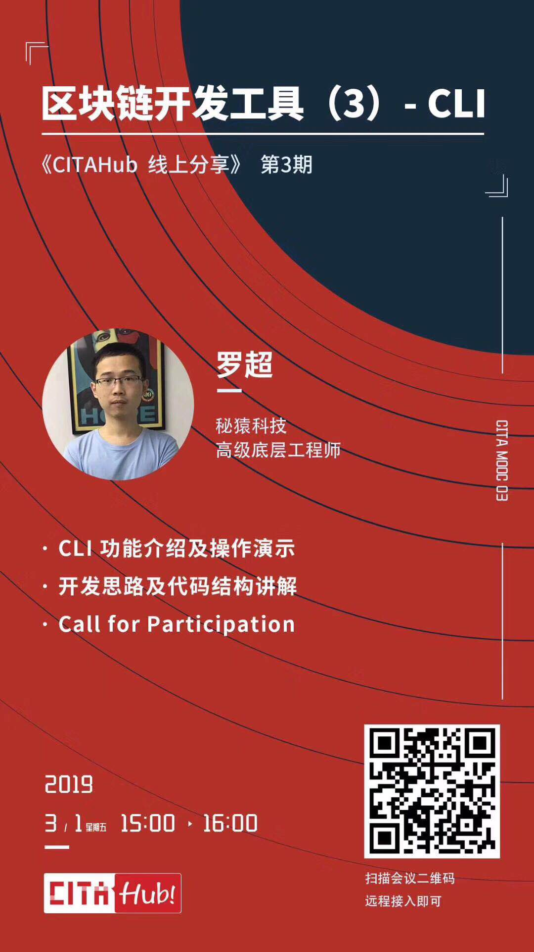
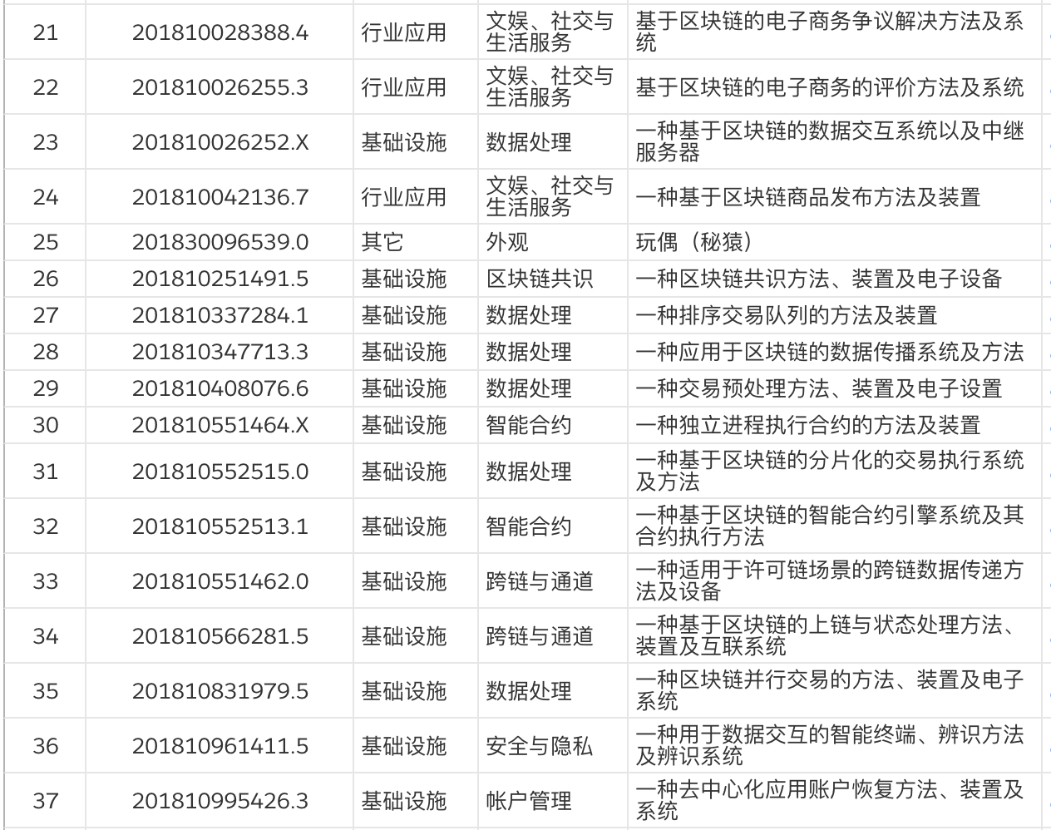




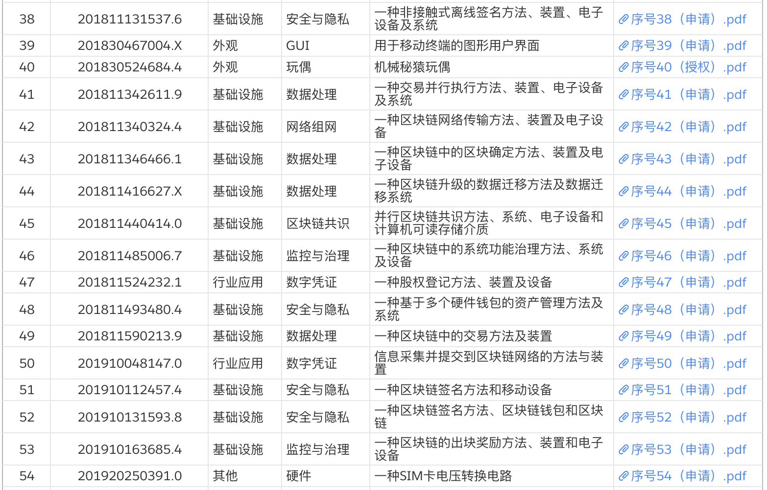
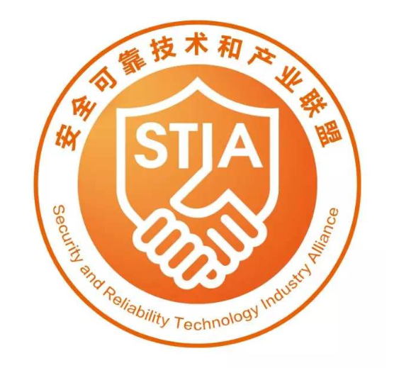





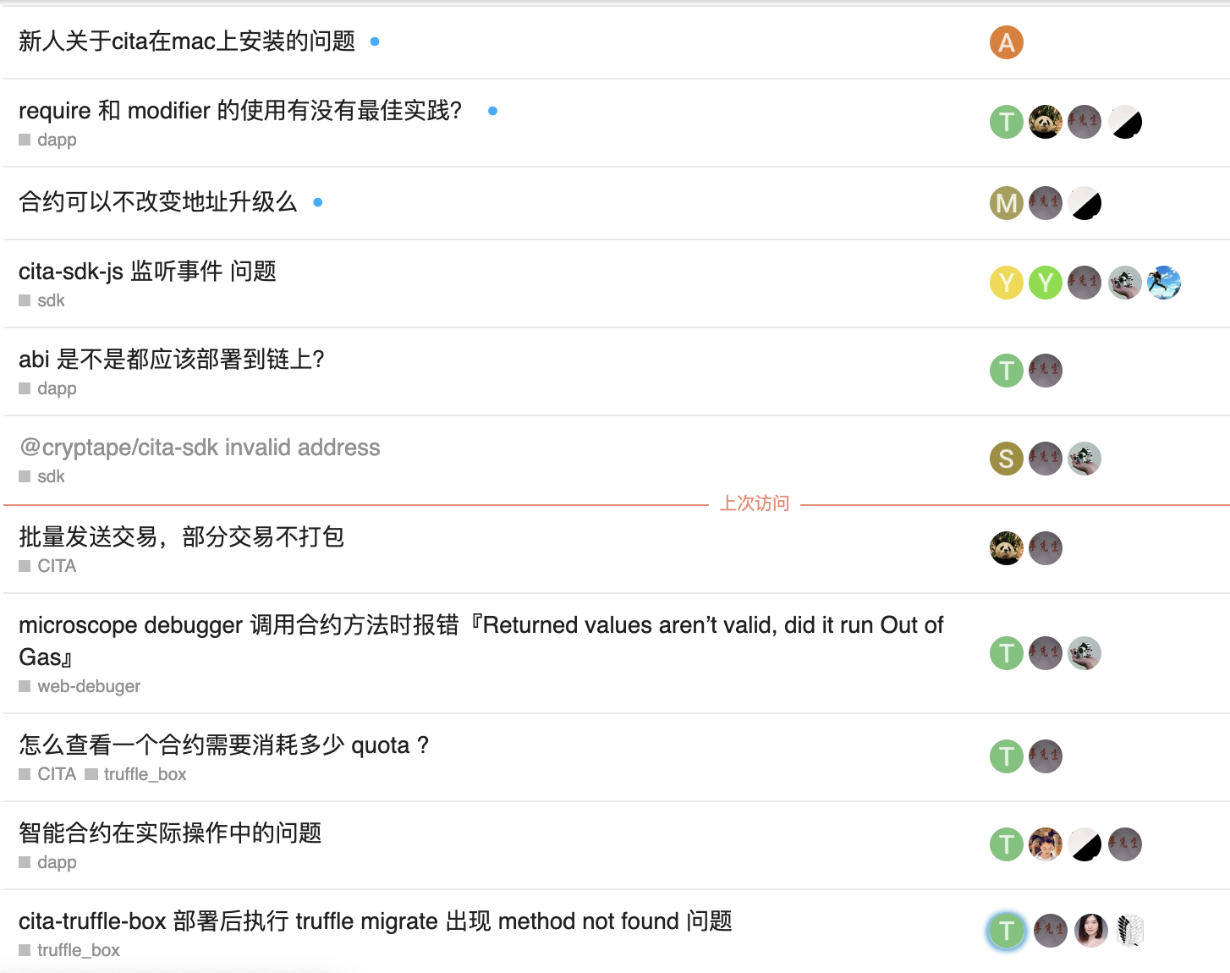



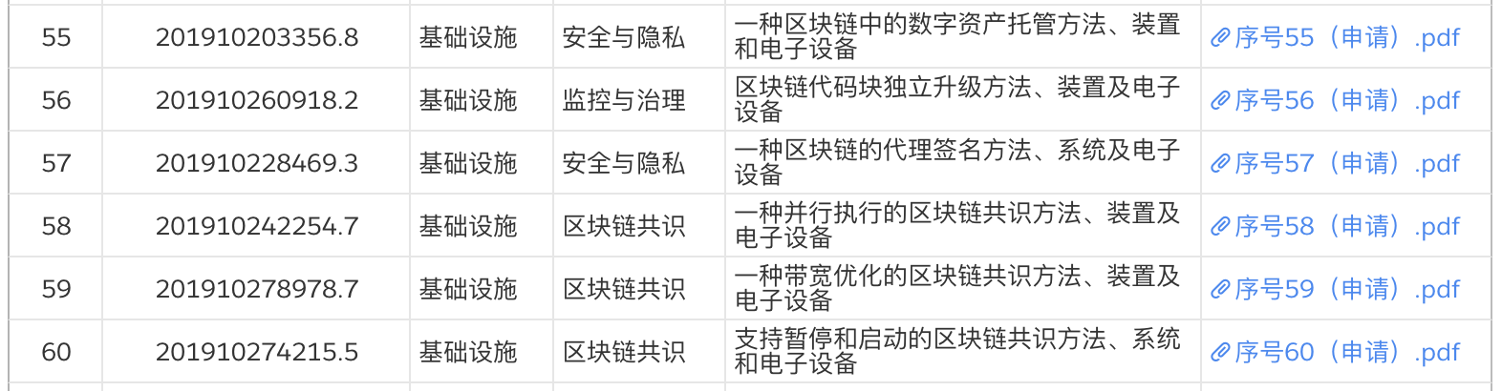
A leading provider of integrated blockchain solutions
Core Technologies
1. First microservice architecture blockchain | 2. CITA：First Chinese open-source underlying blockchain
3. First adoption of Chinese national cryptographic algorithm | 4. First implement mainstream privacy algorithms
100+
1ST
100+
5
Patents for Invention
Open-source community
Partners
Domestic standards

Slide 3
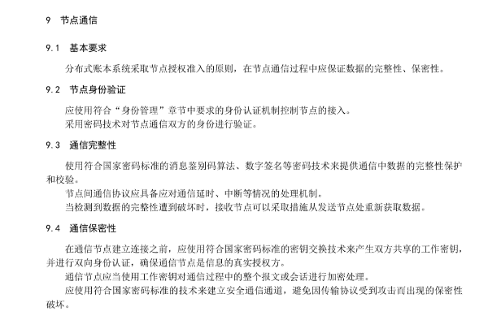
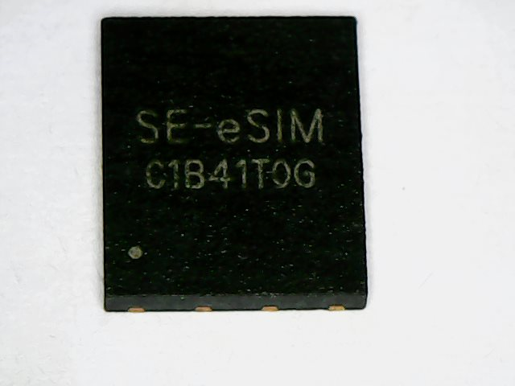
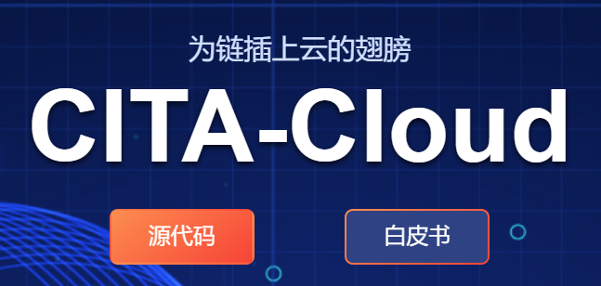
Core Superiorities
Right out of the box
Meet the financial level application standards and specifications
Support cross-cloud, cross-organization deployment of the blockchain system
Privacy Protection
Business Pro
Data Reliable
In the ledger data level and network communication level (TLS protocol) have achieved a complete national cryptographic algorithm adaptation.
Initiate the Cloud-native blockchain framework CITA-Cloud, reuse Cloud-native capabilities, decouple blockchain functional modules.
Independent developed blockchain chip, realized IOT Data acquisition directly on the blockchain, which ensures the Reliability of the Data.

Slide 4
Trustworthy Trace：Household Waste Separation
Classification Bag
Recycling Station
Credit Record
Blockchain Trace
Waste Trace APP
Hazardous
Pay for Pickup
Income Withdrawal

Slide 5



Embodied Energy：Trace based on Blockchain
Recycle
EE：Embodied Energy
Commodity labeling EE;
Consumer refund base on EE;
Dealer make price base on EE;
Funds invest base on EE Data;
Government give Subsidies base on EE Data.
Blockchain trace makes EE Data trustworthy.
Invest
Reference
Government
Funds
EE-trace
Consumer
Dealer
Subsidies
Reference
Refund
Industry
Business

Slide 6
THANKS
WITNESS VALUE/BLOCKCHAIN TRUST

