Slide 1
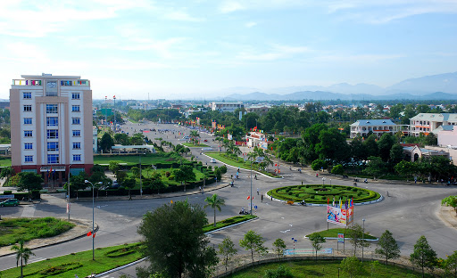




Tam Ky City Climate Action Planning
Draft Results as of November 2020

Slide 2
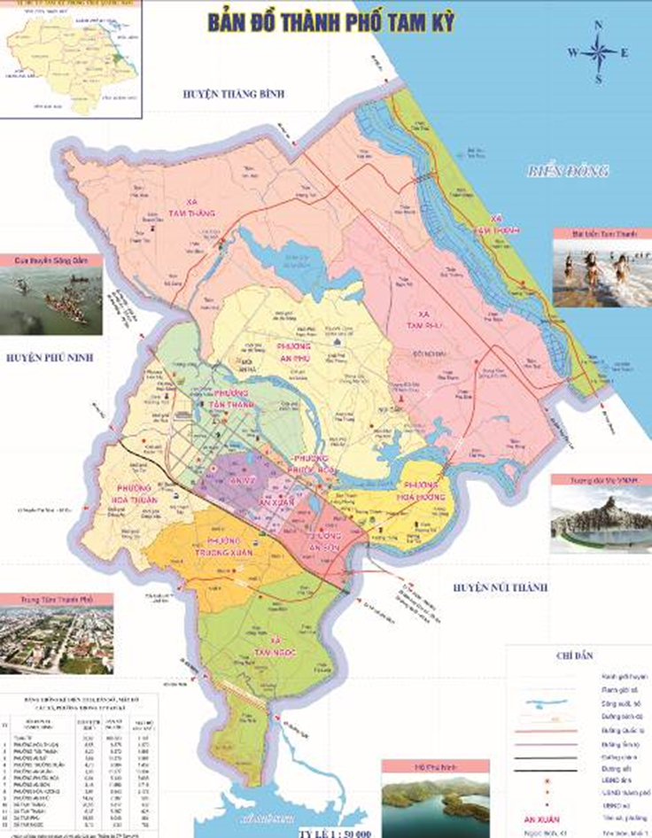
Tam Ky City, Quang Nam province, Vietnam
Total area is 9,263.56 ha.
By 2019: Total population of about 150,000 people, is the central city of Quang Nam province.
Administratively, the city has 09 urban wards (Truong Xuan, An My, An Phu, An Son, An Xuan, Hoa Huong, Hoan Thuan, Phuoc Hoa and Tan Thanh), and 4 communes (Tam Ngoc, Tam Phu, Tam Thang and Tam Thanh).

Slide 3
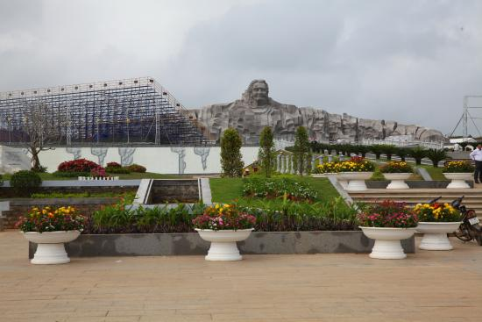
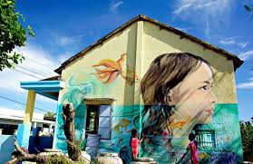
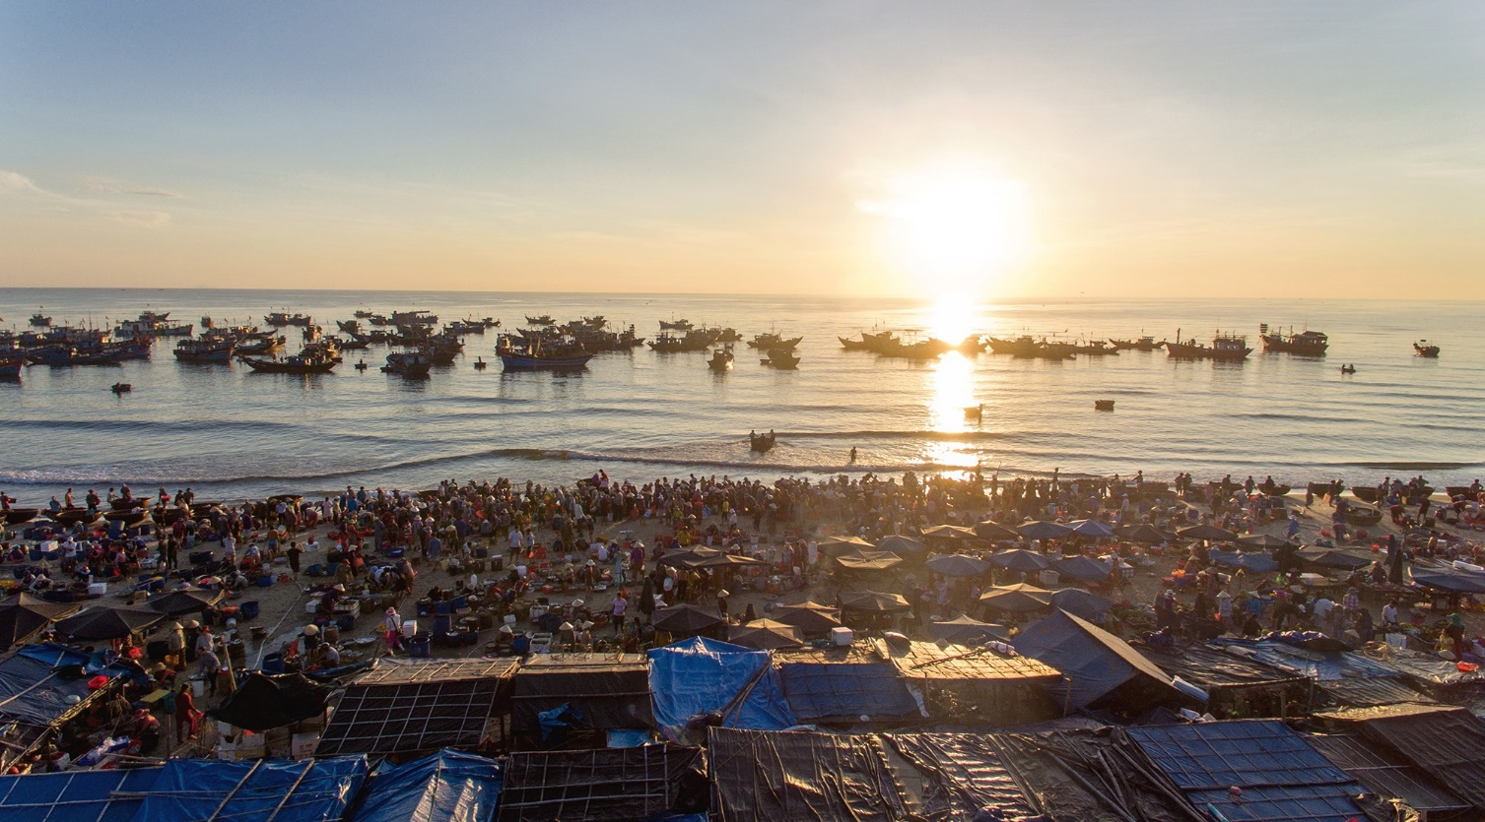
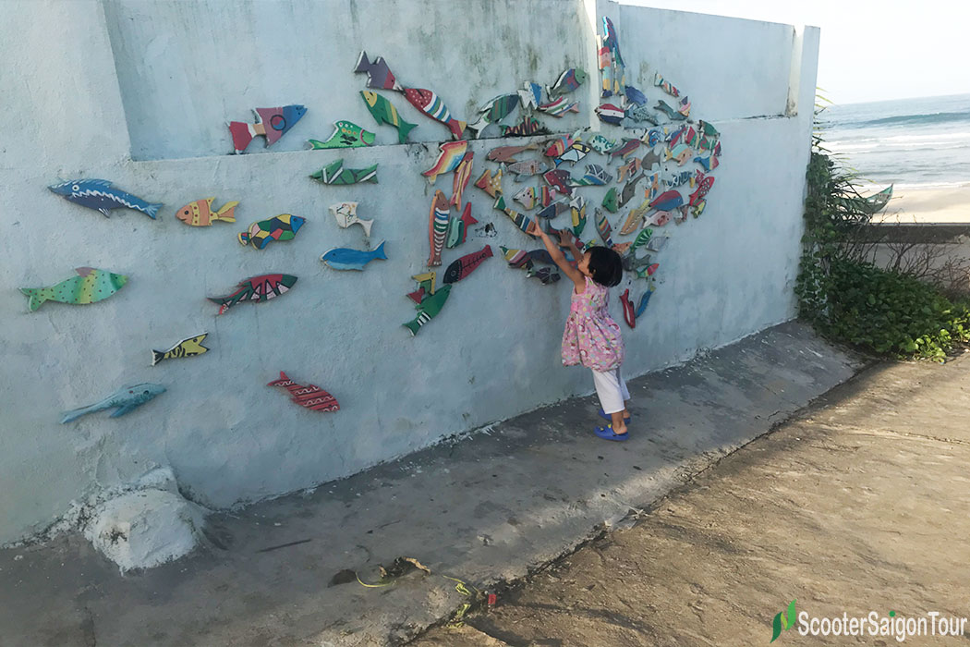

Slide 4
Targets and Objectives
For Mitigation and Adaptation

Slide 5
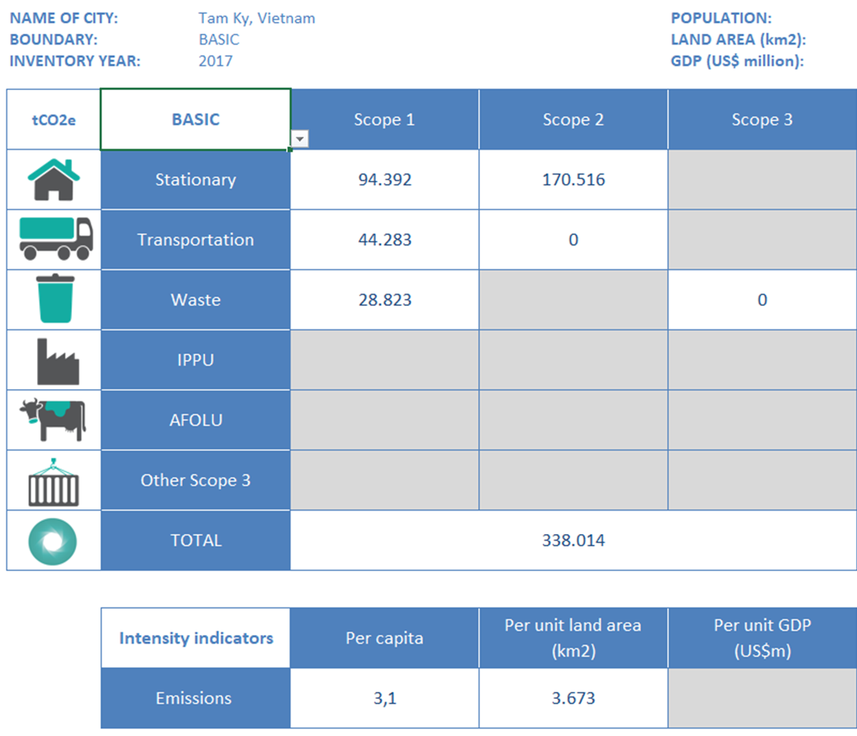
Tam Ky Proposed CAP
Mitigation Targets (period until 2030)
Adaptation Goals
Consistent with the Viet Nam NDC, 9% reduction in total greenhouse gas emissions compared to the BAU scenario
Elements at Risk | Adaptation Goals/Objectives
Population | Strengthening the adaptive capacity of communities and households (esp infants and elderly people and street workers), particularly in flood-prone areas: Tam Thang commune, Tan Thanh, Phuoc Hoa, Hoa Huong ward
Infrastructure | Roads; power supply stations and electricity lines; water supply systems and fresh water reservoirs
Land Use | Land for urban agriculture with climate resilience, particularly in flood-prone areas; increase green areas in the city .

Slide 6
Mitigation Specific Actions
Strategies/Projects/Activities

Slide 7
Potential Mitigation Actions
Sector | Target for the Action for the CAP period | Actions to Achieve the Target
 |  | Already Planned | Proposed New or Adjusted Actions
Stationary Energy | 5 percent of energy losses will be secured | Energy saving program | Introduce solar panel and mini wind power station in suitable communities Smart grid
Transportation | Increase 10% of people using public transport; | Public transportation program Improve bus infrastructure, services, and operations | Create a better facility for people using public transportation and bikes, for example setup bike parking station for free and bike rental Improve fuel economy and reduce CO2 from bus and/or light rail
Water | Reduce 5-10% of water losses | Clean water supply | Water pricing and water conservation schemes introduced Water recycling and reclamation

Slide 8
Potential Mitigation Actions
Sector | Target for the Action for the CAP period | Actions to Achieve the Target
 |  | Already Planned | Proposed New or Adjusted Actions
Waste | Deploying waste separation at source, minimizing plastic waste | Recycling or composting collections and/or facilities Waste prevention policies and programs | Improve the efficiency of waste collection Recyclables and organics separation from other waste

Slide 9
Prioritized Adaptation Actions
Strategies/Projects/Activities

Slide 10
Measure to reduce vulnerabilities to the most effected population
 | Already Planned/Doing | New/enhanced actions
Elderly population | Social housing and healthcare centres | Transforming public building into shelter in case of disaster taken place
Women and infants | Children protection programme | Awareness raising for the whole society
Out-door workers |  | Awareness raising on disaster risk reduction measures
Fishing men | Early warning system | Training to use modern communication devices

Slide 11
Measure to reduce vulnerabilities to the critical infrastructure
 | Already Planned/Doing | New/enhanced actions
Roads expose to flooding | Upgrading the drainage system | Regular and on-event based maintenance programme and integrate climate risks into designing and constructing process
Power station and electricity transmission lines expose to high risk of overheated and fired due to heatwave and rising temperature | Upgrading the electricity line system | Undergrounding the electricity line system for the city
Facilities in economic and industrial zones/ cluster |  | Maintenance programme and

Slide 12
Next steps
Id | Contents | Implementation | Participation
1 | Validate data and review all the proposed actions to be consistent with the new socio-economic development plan for 2021-2030 and the provincial action plan responding to climate change | City Office | Experts from line division and DONRE
2 | Organize the consultation meetings in the city’s divisions and communes to reviews the needs and relevance of the proposed adaptation and mitigation | City Office | The city departments
3 | Update and finish the action plan of Tam Ky city inline with the available resources | City Office
4 | Submit to Quang Nam PC for participating and become a member of GCOM | City Office

